Slide 1
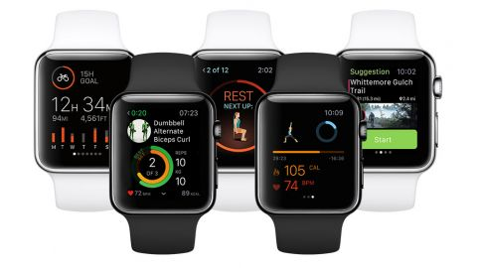
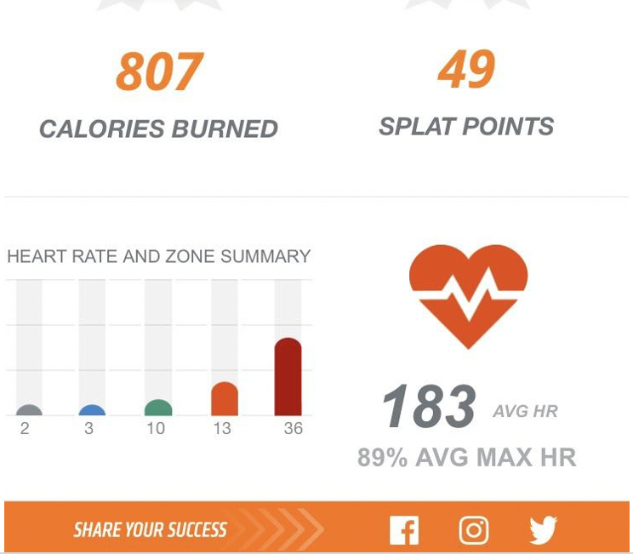
FITNESS BIT

Slide 2
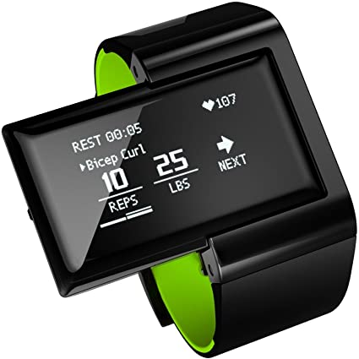
Industry : Health & Fitness
When we talk about fitness in the past - years ago, most of them did not have the necessary money to pay for a personal trainer/coach who would motivate/devote us and therefore as a result people used to train themselves which lead to exercising improperly and inefficiently which has caused a negative impact to their own body by taking on poor training habits and by not able to achieve the desired results which they were aiming for
On a good note technology has been advancing at a faster pace, we have learned from our mistakes in the past and have advanced from a technical and biological standpoint. This is a perfect time to leverage some of the advanced technologies which will change the fitness industry by allowing people to achieve/make progress in exercise in a more efficient and in a much faster pace
The goal is to improve the quality of fitness through exercise by contributing to improvement of fitness sector which is achieved by interconnecting fitness studios to trainers/coaches, therapies and or manufacturer/supplement providers
Name of our Company : FitnessBit

Slide 3

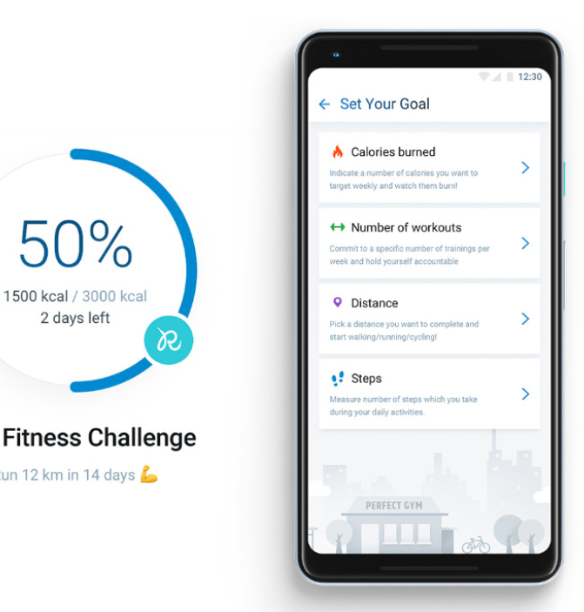
Blockchain technology is deemed to be one of the secure system we have today where a user can exchange data without a third party and without any possible fraud. The fact that it is being housed and run on multiple computers is a clear indication that a single user cannot control (hack) the device/data, nor there is any single point failures
Increased in data privacy on fitness applications will eventually encourage and enable users to gain trust and have more confidence on the platform and therefore interact with the technology in a comfortable manner. Users can have transparent interactions with Trainers/Coaches without needing any intermediaries
As we all know sharing of information is the key in Healthcare Industry, this will help Doctors to evaluate accurate diagnosis about a patient likely for a medical treatment to yield results and we think Blockchain Technology can solve these issues

Slide 4
In the fitness industry, blockchain is fairly new, however there are good amount of apps/software which are being developed/created that uses blockchain to efficiently monitor or analyze results
Lifetime Fitness | Gym Rewards
Orange Theory Fitness | Beat
Sweatcoin | True Gym
wHealth | HealthWizz
Business Description:
As per 2019 data, Fitness industry revenue total was around $94billion and is estimated to be around $206 Billion in 2020, more than a double increase in the coming years. The main goal of the app is to evolve and bring a revolutionary change to fitness industry which will benefit everyone involved in the transaction. An App which will connect users to trainers, coaches, nutritional supplement vendors, fitness machine manufacturers etc.. With the amount of the data collected our AI will kick in to construct a tailored workout plan best suited for their needs and help the users to achieve their goals in a more effective and timely manner by keeping them motivated at the same time.

Slide 5
We will own and also franchise few Fitnessbit studios to manage fitnessbit centers based on our budget and best match the training through site selections, trainer system to users. Users will be able to get in touch with the trainer/coaches anytime virtually for consultation
The plan is to develop our own Blockchain to store data from the Users application which can be any form of smart devices like smart phones, smart watches, fitness wearables and or any Internet of Thing technologies. Every user can decide whether or not to share data in return for a reward (fitnessbit coins) which can be used to contribute towards their membership or buy any nutritional supplements or to purchase any accessories on the website. All the data will be securely stored on the Blockchain Network and the users will have the ability to see their entire history
Problem that your startup will solve
One of the most important advantages our startup will solve is current currency transaction and support, The app will provide the ability to transact between two parties without the need/relying on any third-party institutions
Making the data available In a chronological order to better track transactions made along the chain/way

Slide 6
Solution/Product or Service Idea
With Evolving technology, most of the companies are finding ways to capitalize Blockchain technology, our team is committed to provide support to fitness bit application which includes development of cryptocurrencies, encouraging healthy lifestyle and develop a decentralized ecosystem for our startup
Intellectual Property / Special Know-How
The challenges associated with patent/copyright protection have grown bigger, we live in a generation where almost anybody can download your work for their personal use without your consent. With development of Blockchain, the process of protecting/defending intellectual property has become much more streamlined which clearly tells where/who the copyrights belongs to. It is important to know what can and cannot be protected, we will consider patent through US patent and Trademark Office which will cover and protect our app down the road
In a fast-growing ecosystem which is largely built on Open source technology the protection of intellectual property becomes an important concern, the following are few steps which we are planning to take to avoid any impact on intellectual property
Acquire IP – blockchain will create tokens for underlying asset which also includes title rights
License the product – contract agreements needs to be signed among users and IP owners who license the use of their contents
By controlling the copyrights contract terms between the partners will improve operations across the users, trainers, suppliers or any thridparty, therefore capturing the real time time flow of payments

Slide 7
Market Analysis
Fitness apps have always been a huge phenomenon since 2010 and they have continued to grow and become popular every year. The growth of a Fitness app is much quicker when compared to other categories and the application is said to be used at least 2 times a day than the other app categories. A study on Internet shows that 35% of adults who are regularly on Internet intend to purchase a Fitness application for themselves next year
Despite the fast-growing industry, study shows that most consumers have shifted their spend from going to a traditional gym to what is called on-line services. By developing the app that rewards fitness evey time they take a workout i.e, run, walk , swim etc encourages a healthy and fit lifestyle by building an ecosystem that allows both the users, trainers and the owners of the studio to benefit
Sales and Market Strategy
As spending is shifting from traditional gym memberships to online fitness, our company being on a blockchain platform will seamlessly transition by cutting the middle-man from the equation. The app will provide the users with direct access to match the same experience they would get in a gym by connecting them with their coaches/trainers through videos which can be directly downloadable from blockchain Network
Increased data privacy and transparent interactions between the coaches/training professionals without needing for a third-party intermediaries will help users gain confidence and become comfortable with the platform

Slide 8
Funding Strategy
Find / Search for a partner who can fund the app with the idea it is being built
Setting up Crowd Funding Campaign for flexible and fixed funding options
In- App Purchases
Premium Subscriptions plans
Advertisements
Sponsored Cuntent
Ecommerce

Slide 9
References:
https://fitprince.com/blockchain-in-fitness/
https://medium.com/@ainthavinit33/how-blockchain-will-change-the-fitness-industry-business-model-489eb0b31549
https://svpool.com/tech/blockchain-and-fitness-why-the-two-are-a-natural-match/
https://www.ihrsa.org/improve-your-club/industry-news/2019-fitness-industry-trends-shed-light-on-2020-beyond/
https://www.google.com/url?sa=i&url=https%3A%2F%2Fe-hir.org%2Fm%2Fjournal%2Fview.php%3Fnumber%3D1006&psig=AOvVaw3scDxX1NWkW1DhZRGa0RGc&ust=1601824982526000&source=images&cd=vfe&ved=0CAkQjhxqFwoTCNDlsajdmOwCFQAAAAAdAAAAABAj
https://digitalchamber.org/initiatives/blockchain-intellectual-property-council/

